Slide 1
Software Evolution and Maintenance
A Practitioner’s Approach
Chapter 3
Evolution and Maintenance Models
Notes:
Handouts
------------------------------------------------------------------
------------------------------------------------------------------
-------------------------------------------------------------------
--------------------------------------------------------------------

Slide 2
Outline of the Chapter
3.1 General Idea
3.2 Reuse Oriented Model
3.3 The Staged Model for CSS
3.4 The Staged Model for FLOSS
3.5 Change Mini-Cycle Model
3.6 IEEE/EIA 1219 Maintenance Process
3.7 ISO/IEC 14764 Maintenance Process
3.8 Software Configuration Management
3.8.1 SCM Spectrum of Functionality
3.8.2 SCM Process
3.9 Change Request Workflow
Notes:
Handouts

Slide 3
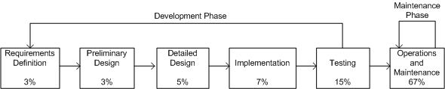
3.1 General Idea
One traditional software development life cycle (SDLC) is shown in Figure, which comprises two discrete phases, namely:
  development and
  maintenance
Maintenance approaching two-thirds of the product life-span.
The percentages in Figure 3.1 indicate relative costs.
Figure 3.1: Traditional SDLC model ©Wiley, 1988
Notes:
Handouts

Slide 4
3.1 General Idea
Software maintenance has unique characteristics:
Constraints of an existing system: Maintenance is performed on an operational system. Therefore, all modifications must be compatible with the constraints of the existing architecture, design, and code.
Shorter time frame: A maintenance activity may span from a few hours to a few months, whereas software development may span one or more years.
Available test data: In software development, test cases are designed from scratch, whereas software maintenance can select a subset of these test cases and execute them as regression tests.
Software maintenance should have its own Software Maintenance Life Cycle (SMLC) model as it involves many unique activities.
Notes:
Handouts

Slide 5
3.2 Reuse Oriented Models
One obtains a new version of an old system by modifying one or several components of the old system and possibly adding new components.
Based on this concept, three process models for maintenance have been proposed by Basili:
  Quick fix model: In this model, necessary changes are quickly made to the code and then to the accompanying documentation.
  Iterative enhancement model: In this model, first changes are made to the highest level documents. Eventually, changes are propagated down to the code level.
  Full reuse model: In this model, a new system is built from components of the old system and others available in the repository.
Notes:
Handouts

Slide 6
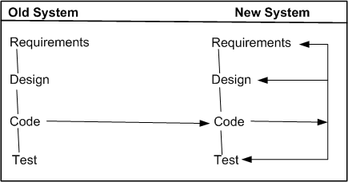
3.2 Reuse Oriented Models
In Quick Fix Model, as illustrated in Figure 3.2
source code is modified to fix the problem;
necessary changes are made to the relevant documents; and
the new code is recompiled to produce a new version.
Often changes to the source code are made with no prior investigation such as analysis of impact of the changes, ripple effects of the changes, and regression testing.
Figure 3.2 The quick fix model ©IEEE, 1990
Notes:
Handouts

Slide 7
3.2 Reuse Oriented Models
Iterative Vs. Incremental
The terms iteration and increment are liberally used when discussing iterative and incremental development.
However, they are not synonyms in the field of software engineering.
Iteration implies that a process is basically cyclic, thereby meaning that the activities of the process are repeatedly executed in a structured manner.
Iterative development is based on scheduling strategies in which time is set aside to improve and revise parts of the system under development.
Incremental development is based on staging and scheduling strategies in which parts of the system are developed at different times and/or paces, and integrated as they are completed.
Notes:
Handouts

Slide 8
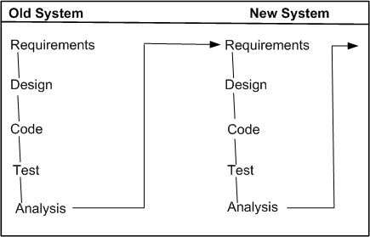
3.2 Reuse Oriented Models
The iterative enhancement model, explained in Figure 3.3, shows how changes flow from the very top level documents to the lowest-level documents.
The model works as follows:
It begins with the existing system’s artifacts, namely, requirements, design, code, test, and analysis documents.
It revises the highest-level documents affected by the changes and propagates the changes down through the lower-level documents.
The model allows maintainers to redesign the system, based on the analysis of the existing system.
Figure 3.3 The iterative enhancement model ©IEEE, 1990
Notes:
Handouts

Slide 9
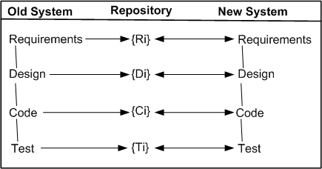
3.2 Reuse Oriented Models
The main assumption in this model is the availability of a repository of artifacts describing the earlier versions of the systems.
In the full reuse model, reuse is explicit and the following activities are performed:
  identify the components of the old system that are candidates for reuse
  understand the identified system components.
  modify the old system components to support the new requirements.
  integrate the modified components to form the newly developed system.
Figure 3.4 The full reuse model ©IEEE, 1990
Notes:
Handouts

Slide 10
3.3 The Staged Model for CSS
Rajlich and Bennett have presented a descriptive model of software evolution called the staged model of maintenance and evolution.
Its primary objective is at improving understanding of how long-lived software evolves, rather than aiding in its management.
Their model divides the lifespan of a typical system into four stages:
  Initial development – The first delivered version is produced. Knowledge about the system is fresh and constantly changing. In fact, change is the rule rather than the exception. Eventually, an architecture emerge and stabilizes.
  Evolution – Simple changes are easily performed and more major changes are possible too, albeit the cost and risk are now greater than in the previous stage. Knowledge about the system is still good, although many of the original developers will have moved on. For many systems, most of its lifespan is spent in this phase.
  Servicing – The system is no longer a key asset for the developers, who concentrate mainly on maintenance tasks rather than architectural or functional change. Knowledge about the system has lessened and the effects of change have become harder to predict. The costs and risks of change have increased significantly.
  Phase out – It has been decided to replace or eliminate the system entirely, either because the costs of maintaining the old system have become prohibitive or because there is a newer solution waiting in the pipeline. An exit strategy is devised and implemented, often involving techniques such as wrapping and data migration. Ultimately, the system is shut down.
Notes:
Handouts

Slide 11
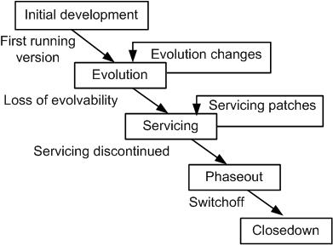
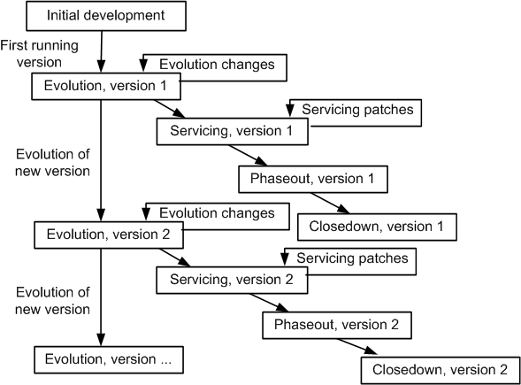
3.3 The Staged Model for CSS
The evolution process is the backbone of the model.
Figure 3.5 The simple staged model for the CSS life cycle ©IEEE, 2000
Figure 3.6 The versioned staged model for the CSS life cycle ©IEEE, 2000
Notes:
Handouts

Slide 12
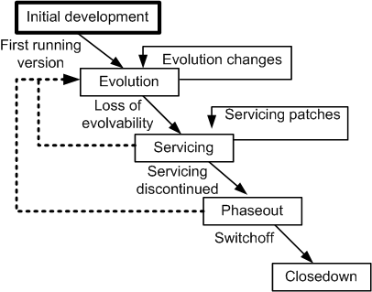
3.4 The Staged Model for FLOSS
Three major differences are identified between CSS systems and FLOSS systems.
In Figure 3.7, the rectangle with the label “Initial development” has been visually highlighted because it can be the only initial development stage in the evolution of FLOSS systems. In other words, it does not have any evolution track for FLOSS system.
With some systems that were analyzed, after a transition from Evolution to Servicing, a new period of evolution was observed. This possibility is depicted in Figure as a broken arc from the Servicing stage to the Evolution stage.
In general, the active developers of FLOSS systems get frequently replaced by new developers. Therefore, the dashed line in Figure exhibits this possibility of a transition from Phase out stage to Evolution stage.
Figure 3.7 The staged model for FLOSS system ©ACM, 2007
Notes:
Handouts

Slide 13
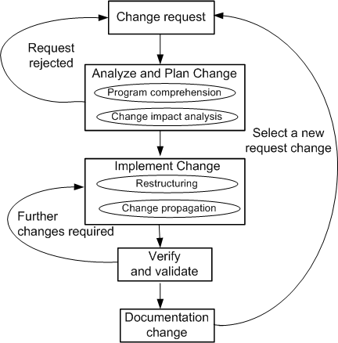
3.5 Change Mini-Cycle Model
Software change is a process that may introduce new requirements to the existing system, or may need to alter the software system if requirements are not correctly implemented. In order to capture this, an evolutionary model known as change mini-cycle was proposed by Yau et al. in the late seventies.
Figure 3.8 The change mini-cycle ©Springer, 2008
Notes:
Handouts

Slide 14
3.6/3.7 Software Maintenance Standard
IEEE and ISO have both addressed s/w maintenance processes.
IEEE( Institute of Electrical and Electronics Engineers )/EIA(Electronic Industries Association) 1219 and ISO(International Organization for Standardization)/IEC (International Electrotechnical Commission) 14764 as a part of ISO/IEC12207 (life cycle process).
IEEE/EIA 1219 organizes the maintenance process in seven phases:
  problem identification, analysis, design, implementation, system test, acceptance test and delivery.
ISO/IEC 14764 describes s/w maintenance as an iterative process for managing and executing software maintenance activities.
The activities which comprise the maintenance process are:
  process implementation, problem and modification analysis, modification implementation, maintenance review/acceptance, migration and retirement.
Each of these maintenance activity is made up of tasks. Each task describes a specific action with inputs and outputs.
Notes:
Handouts

Slide 15
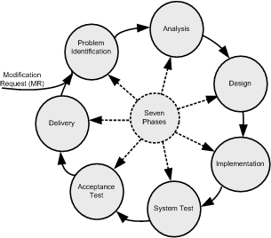
3.6 IEEE/EIA 1219 Maintenance Process
The standard focuses on a seven-phases:
Problem Identification.
Analysis.
Design.
Implementation.
System Test.
Acceptance Test.
Delivery.
Figure 3.9 Seven phases of IEEE maintenance process ©IEEE, 2004
Each of the seven activities has five associated attributes as follows:
Activity definition: This refers to the implementation process of the activity.
Input: This refers to the items that are required as input to the activity.
Output: This refers to the items that are produced by the activity.
Control: This refers to those items that provide control over the activity.
Metrics: This refers to the items that are measured during the execution of the activity.
Notes:
Handouts

Slide 16
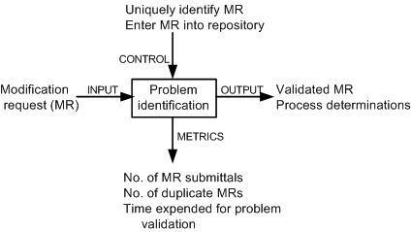
3.6 IEEE/EIA 1219 Maintenance Process
1- Problem identification phase
A request for change to the software is normally made by the users of the software system or the customers, and it starts the maintenance process.
The request for change (CR) is submitted in the form of a modification request (MR) for a correction or for an enhancement. MR & CR are used interchangeably.
Activities included in this phase are as follows:
  reject or accept the MR,
  identify and estimate the resources needed to change the system; and
  put the MR in a batch of changes scheduled for implementation.
Notes:
Handouts

Slide 17
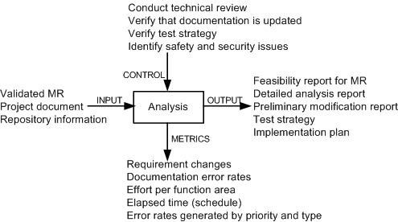
3.6 IEEE/EIA 1219 Maintenance Process
2- Figure 3.11 Analysis phase
The process is viewed to have two major components:
(i) feasibility analysis.
(ii) detailed analysis.
First, feasibility analysis is performed to: (i) determine the impact of the change; (ii) investigate other possible solutions including prototyping; (iii) assess both short-term and long-term costs; and (iv) determine the benefits of making the change.
The second phase identifies: (i) firm modification requirements; (ii) the software components involved; (iii) an overall test strategy; and (iv) an implementation plan.
Notes:
Handouts

Slide 18
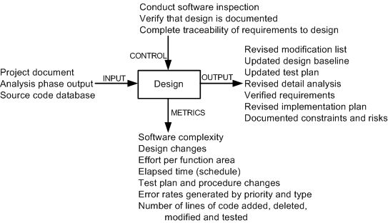
3.6 IEEE/EIA 1219 Maintenance Process
3- Figure 3.12 Design phase
Activities of this phase are as follows:
  (i) identify the affected software components.
  (ii) modify the software components.
  (iii) document the changes.
  (iv) create a test suite for the new design.
  (v) select test cases for regression testing.
Notes:
Handouts

Slide 19
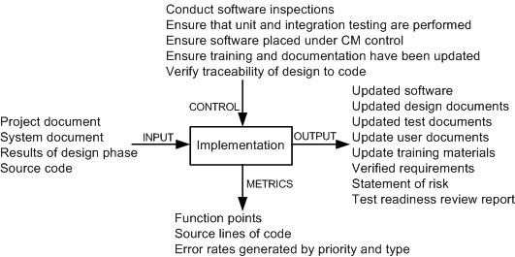
3.6 IEEE/EIA 1219 Maintenance Process
4- Implementation phase
Figure 3.13
The activities executed in this phase are:
  writing new code and performing unit testing,
  integrating changed code,
  conducting integration and regression testing,
  performing risk analysis, and
  reviewing the system for test-readiness.
Notes:
Handouts

Slide 20
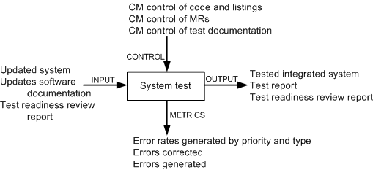
3.6 IEEE/EIA 1219 Maintenance Process
5-System test phase
Figure 3.14
In this phase tests are performed on the full system to ensure that the modified system complies with the original requirements as well as the new modifications.
System-level testing comprises a broad spectrum of testing activities: functionality testing, robustness testing, stability testing, load testing, performance testing, security testing, and regression testing.
Notes:
Handouts

Slide 21
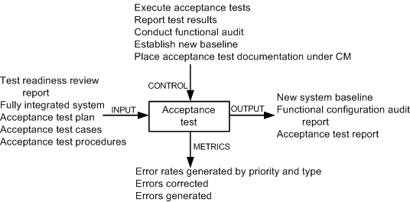
3.6 IEEE/EIA 1219 Maintenance Process
6- Acceptance test phase
Figure 3.15
Acceptance testing is performed on a completely integrated system, and it involves customers, users, or their representatives.
The main objective of acceptance testing is to assess the overall quality of the system, rather than actively identify defects.
An important concept in acceptance testing is the customer’s expectation from the system.
Notes:
Handouts

Slide 22
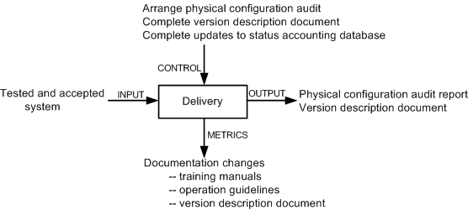
3.6 IEEE/EIA 1219 Maintenance Process
7- Figure 3.16 Delivery phase
In this phase, the changed system is released to customers for installation and operation.
Included in this phase are the following activities: notify the user community, perform installation and training, and develop an archival version of the system for backup.
Notes:
Handouts

Slide 23
3.7 ISO/IEC 14764 Maintenance Process
ISO/IEC 14764 is an international standard for software maintenance.
It describes maintenance using the same concepts as IEEE/EIA 1219 except that they are depicted slightly differently.
The basic structure of an ISO process is made up of activities, and an activity is made up of tasks.
Upon an activation of the maintenance process, plans and procedures are developed and resources are allocated to carry out maintenance.
In response to a change request, code is modified in conjunction with the relevant documentation.
Modification of the running software without losing the system’s integrity is considered to be the overall objective of maintenance.
Notes:
Handouts

Slide 24
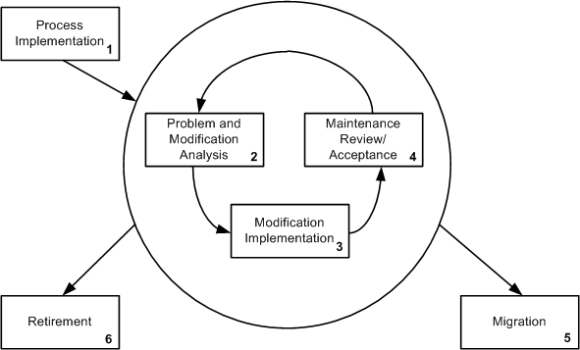
3.7 ISO/IEC 14764 Maintenance Process
The maintenance process comprises the following high level activities:
1. Process Implementation.
2. Problem and Modification Analysis.
3. Modification Implementation.
4. Maintenance Review and Acceptance.
5. Migration.
6. Retirement.
Figure 3.17 ISO/IEC 14764 iterative maintenance process ©IEEE, 2004
Notes:
Handouts

Slide 25
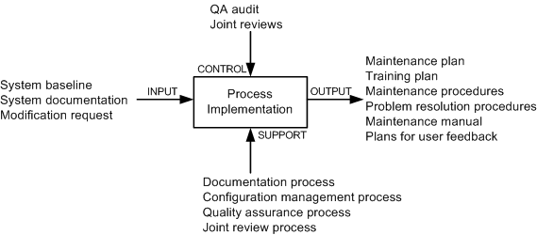
3.7 ISO/IEC 14764 Maintenance Process
1- The process implementation activity consists of three major tasks:
Maintenance plan (next slide).
Modification requests (MR/CR).
Configuration management.
Figure 3.18 Process implementation activity
Notes:
Handouts

Slide 26
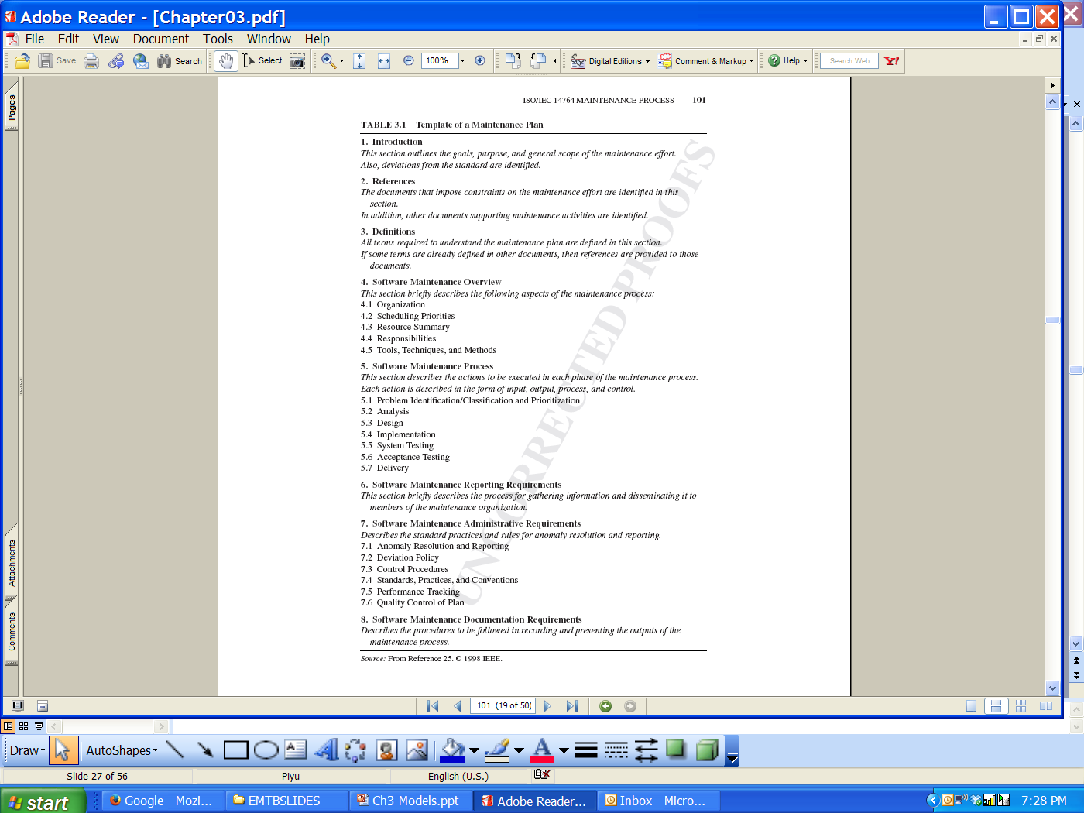
3.7 ISO/IEC 14764 Maintenance Process
Notes:
Handouts

Slide 27
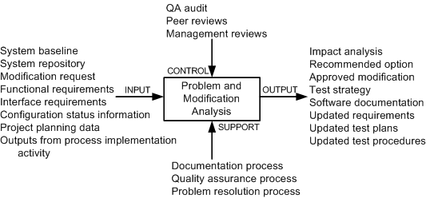
3.7 ISO/IEC 14764 Maintenance Process
2- The problem and modification analysis activity comprises five tasks:
  Modification request analysis.
  Verification.
  Options.
  Documentation.
  Approval.
Figure 3.19 Problem modification activity
Notes:
Handouts

Slide 28
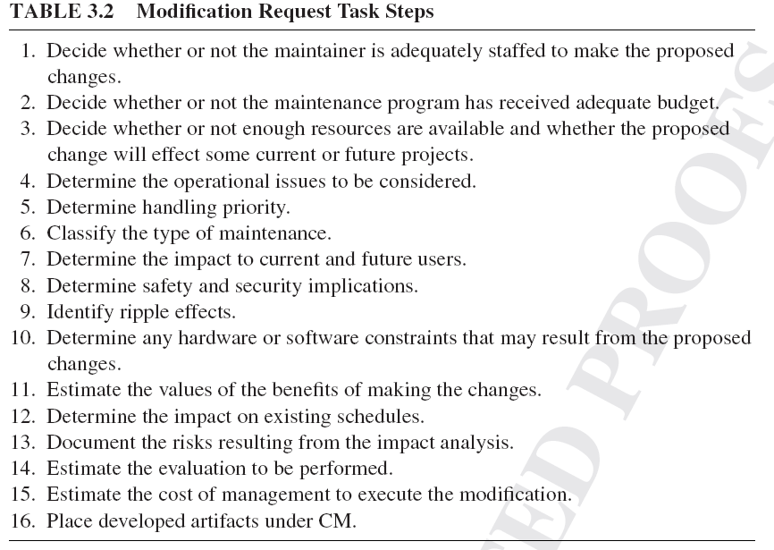
3.7 ISO/IEC 14764 Maintenance Process
Notes:
Handouts

Slide 29
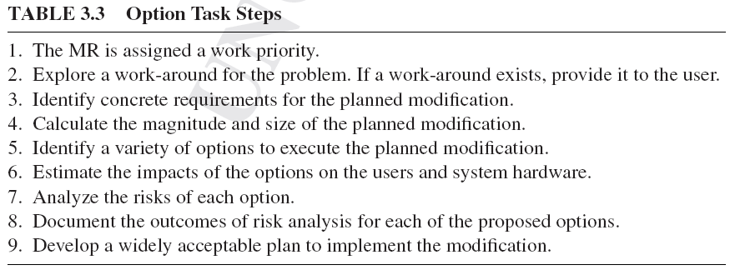
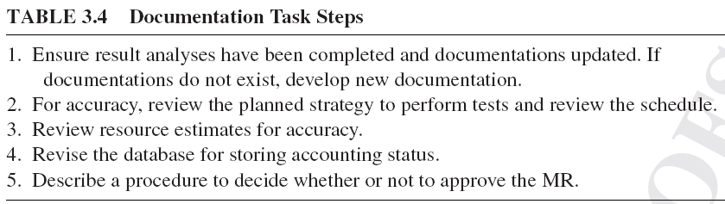
3.7 ISO/IEC 14764 Maintenance Process
Notes:
Handouts

Slide 30
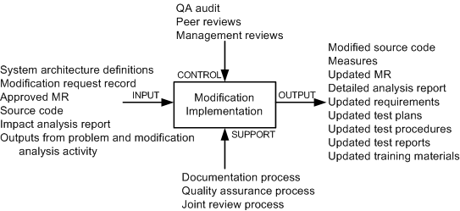
3.7 ISO/IEC 14764 Maintenance Process
3- Modification implementation activity In this activity, maintainers:
(i) identify the items to be modified, and
(ii) execute a development process to actually implement the modifications.
Figure 3.20 Modification implementation activity
Notes:
Handouts

Slide 31
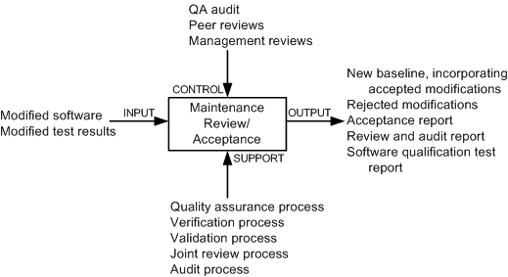
3.7 ISO/IEC 14764 Maintenance Process
4- Maintenance review/acceptance activity
By means of this activity, it is ensured that:
  (i) the changes made to the software are correct, and
  (ii) changes are made to the software according to accepted standards and methodologies.
The activity is augmented with the following processes:
  (i) a process for quality management,
  (ii) a process to verify the product,
  (iii) a process to validate the product, and
  (iv) a process to review the product.
Figure 3.21 Maintenance review/acceptance activity
Notes:
Handouts

Slide 32
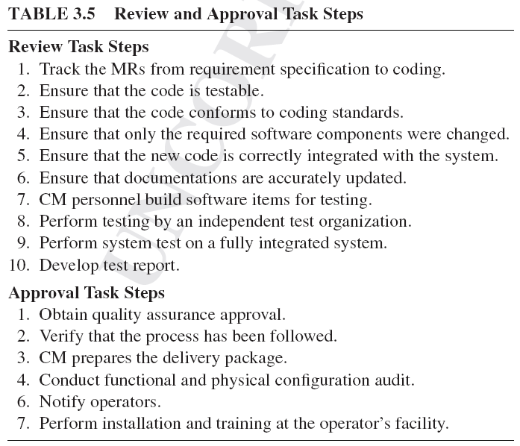
3.7 ISO/IEC 14764 Maintenance Process
Notes:
Handouts

Slide 33
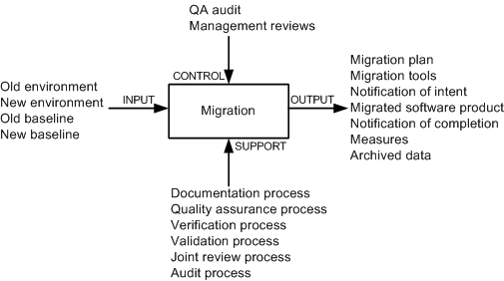
3.7 ISO/IEC 14764 Maintenance Process
5- Migration is effected in two broad phases:
(i) identify the actions required to achieve migration, and
(ii) design and document the concrete steps to be executed to effect migration.
Figure 3.22 Migration activity
Notes:
Handouts

Slide 34
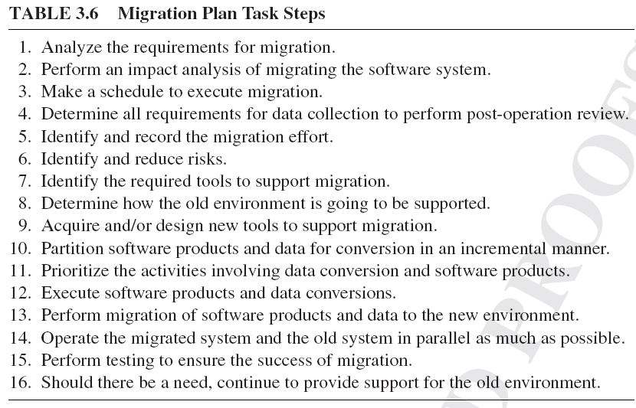
3.7 ISO/IEC 14764 Maintenance Process
Notes:
Handouts

Slide 35
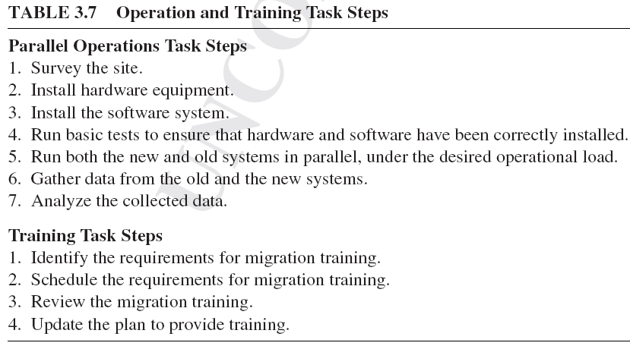
3.7 ISO/IEC 14764 Maintenance Process
Notes:
Handouts

Slide 36
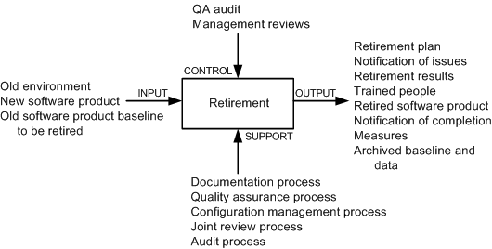
3.7 ISO/IEC 14764 Maintenance Process
6- Retirement activity This activity comprises five tasks:
  Retirement plan
  Notification of intent
  Implement parallel operations and training
  Notification of completion
  Data archival
Figure 3.23 Retirement activity
Notes:
Handouts

Slide 37
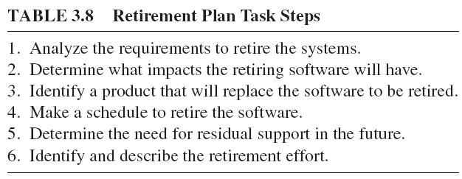
3.7 ISO/IEC 14764 Maintenance Process
Notes:
Handouts

Slide 38
3.8 Software Configuration Management
The concept of configuration management (CM) was developed to manage changes in large systems.
It handles the control of all product items and changes to those items.
Software Configuration Management (SCM) is applied to software products.
The product items include document, executable software, source code, hardware, and disks.
SCM accrues two kinds of benefits to an organization:
  SCM ensures that development processes are traceable and systematic so that all changes are precisely managed.
  SCM enhances the quality of the delivered system and the productivity of the maintainers.
The objectives of SCM are to:
  • Uniquely identify every version of every software at various points in time.
  • Retain past versions of documentations and software.
  • Provide a trail of audit for all modifications performed.
  • Throughout the software life-cycle, maintain the traceability and integrity of the system changes.
Notes:
Handouts

Slide 39
3.8 Software Configuration Management
Projects benefit from effective SCM as follows:
  1. Confusion is reduced and order is established.
  2. To maintain product integrity, the necessary activities are organized.
  3. Correct product configurations are ensured.
  4. Quality is ensured – and better quality software consumes less maintenance efforts.
  5. Productivity is improved, because analysts and programmers know exactly where to find any piece of the software.
  6. Liability is reduced by documenting the trail of actions.
  7. Life cycle cost is reduced.
  8. Conformance with requirements is enabled.
  9. A reliable working environment is provided.
  10. Compliance with standards is enhanced.
  11. Accounting of status is enhanced.
Notes:
Handouts

Slide 40
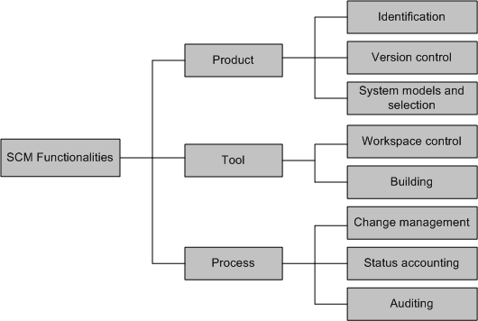
3.8.1 SCM Spectrum of Functionality
Estublier et al. classified the functionalities into three broad areas:
  product,
  tool, and
  Process.
Figure 3.24 Technical dimension of SCM systems
Notes:
Handouts

Slide 41
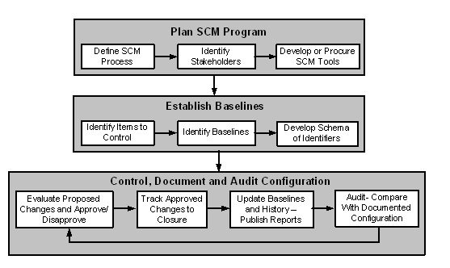
3.8.2 SCM Process
Figure 3.26 shows the three major SCM implementation activities:
    planning,
    baseline development, and
    configuration control.
Figure 3.26 A process for implementing SCM
Notes:
Handouts

Slide 42
3.9 Change Request Workflow
A change request (CR), also called a modification request (MR), is a vehicle for recording information about a system defect, requested enhancement, or quality improvement.
Change requests are placed under the control of a change management system.
Change management systems control changes by an automated system in the form of work-flow.
The basic objective of change management is to uniquely identify, describe, and track the status of each requested change.
The objectives of change management are as follows:
  • Provide a common method for communication among stakeholders.
  • Uniquely identify and track the status of each CR. This feature simplifies progress reporting and provides better control over changes.
  • Maintain a database about all changes to the system. This information can be used for monitoring and measuring metrics.
Notes:
Handouts

Slide 43
3.9 Change Request Workflow
A change request describes the desires and needs of users which the system is expected to implement.
While describing a CR, two factors need to be taken into account:
  • Correctness of CRs, and
  • Clear communication of CRs to the stakeholders.
The results of interpreting a CR in different ways are as follows:
  • The team carrying out actual changes to the system and the team performing tests may develop contradicting views about the new system’s quality.
  • The changed system may not meet the needs and desires of the end users.
CRs need to be represented in an unambiguous manner, and made available in a centralized repository.
Wide availability of CRs to all the stakeholders is likely to reveal differences in interpretations by different groups.
Notes:
Handouts

Slide 44
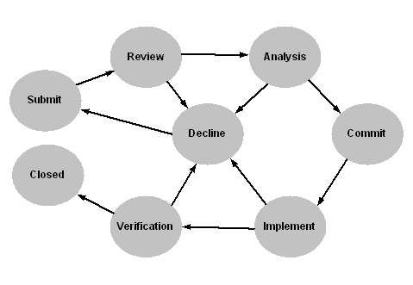
3.9 Change Request Workflow
The life-cycle of a CR has been illustrated in Figure 3.27, by means of a state-transition diagram.
Each state represents a distinct stage in the life-cycle of a CR.
Figure 3.27 State transition diagram of a CR
Notes:
Handouts

Slide 45
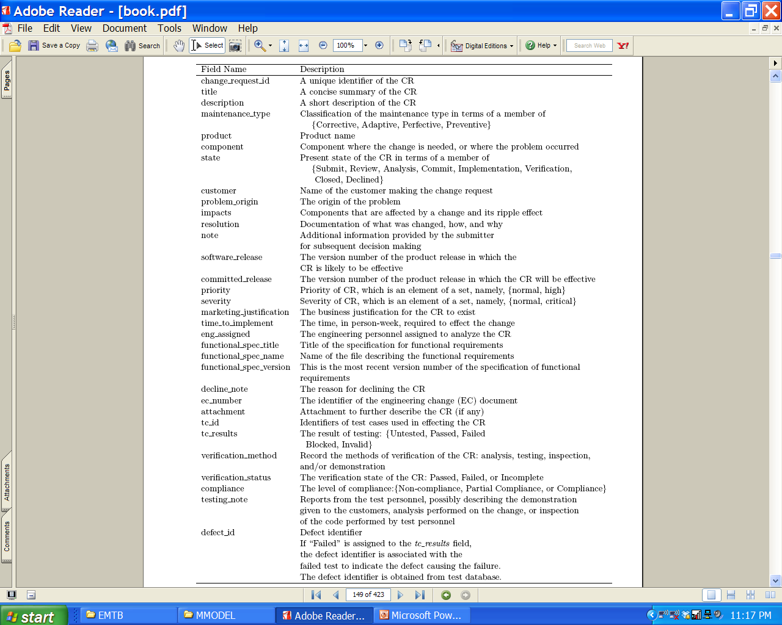
3.9 Change Request Workflow
Table 3.9 Change request schema field summary
Notes:
Handouts

Slide 46
Summary
General Idea
Reuse Oriented Model
The Staged Model for CSS
The Staged Model for FLOSS
Change Mini-Cycle Model
IEEE/EIA 1219 Maintenance Process
ISO/IEC 14764 Maintenance Process
Software Configuration Management
Change Request Work-Flow
Notes:
Handouts

